Slide 1

Hog Bank - Internal
Ethan Ericson, Jaxon Ham, Andrew Mendez, Medhansh Sankaran, Ethan Styles
Notes:
Ericson Starts off – Everyone Introduce

Slide 2
Introduction
Hog Bank is a bank by and for students of the University of Arkansas.
Our task was to ideate and develop the employee-facing database.
Notes:
Medhansh

Slide 3






Project Goals
Notes:
Styles

Slide 4
Phase 1
Ericson : Project Timeline
Jaxon : Conceptual Design
Andrew : Project Proposal
Medhansh : ERD
Styles : Data Dictionary
Notes:
Ericson

Slide 5
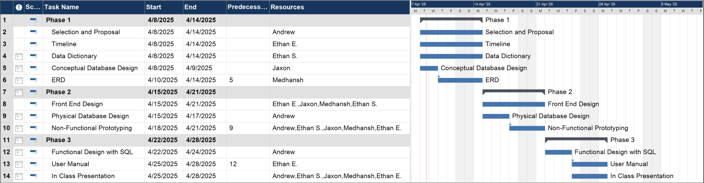
Project Timeline
Notes:
Ericson

Slide 6
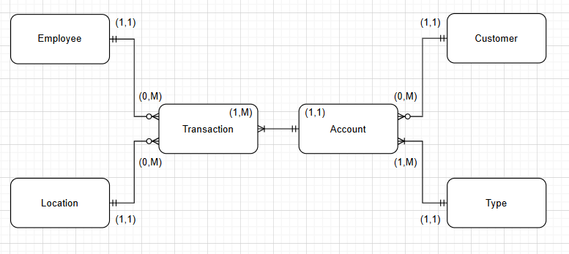
Conceptual Design
Notes:
Jaxon

Slide 7
Project Proposal
Overview
Project Type: Internal Development
Tech Stack: Web app using C# (UI + Logic Handling)
Consulting: Sarah & Professor Shipp for implementation guidance
Core Features
Login: Employee ID + Password
Deposit / Withdraw: Enter Amount, AccountID, LocationID → Submit
Create Account: Input CustomerID, AccountType, Initial Deposit, etc.
Create Customer: Input personal & contact info → Submit
View Customer Info: Drill-down from customer list to account & transactions
Employee Setup: Pre-loaded by branch; no user-level modification yet
Notes:
Andrew

Slide 8
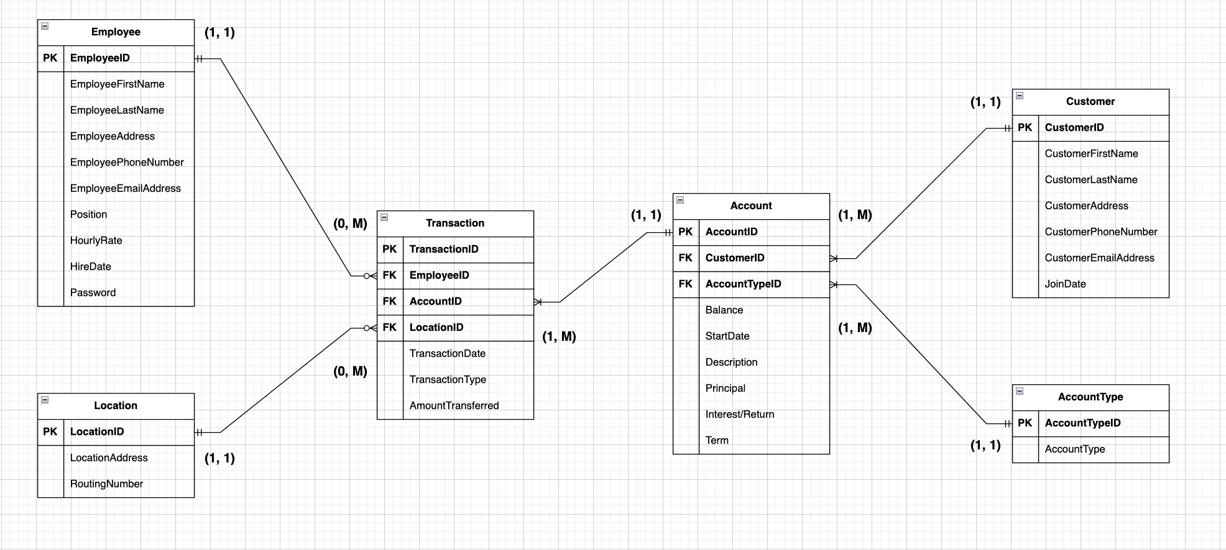
ERD
Notes:
Medhansh – briefly overview the attributes of each entity in the ERD model.

Slide 9
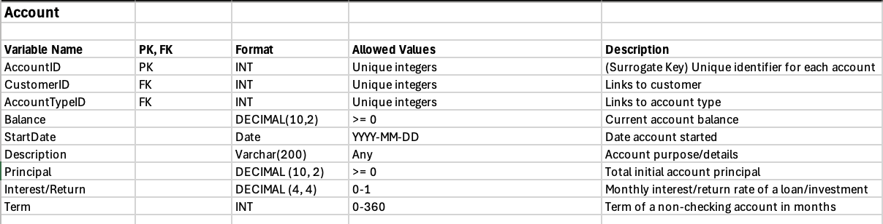
Data Dictionary
Notes:
Styles

Slide 10
Phase 2
Non-Functional Prototype: Ericson, Jaxon, Styles
Physical Database Design : Andrew, Medhansh
Notes:
Andrew

Slide 11
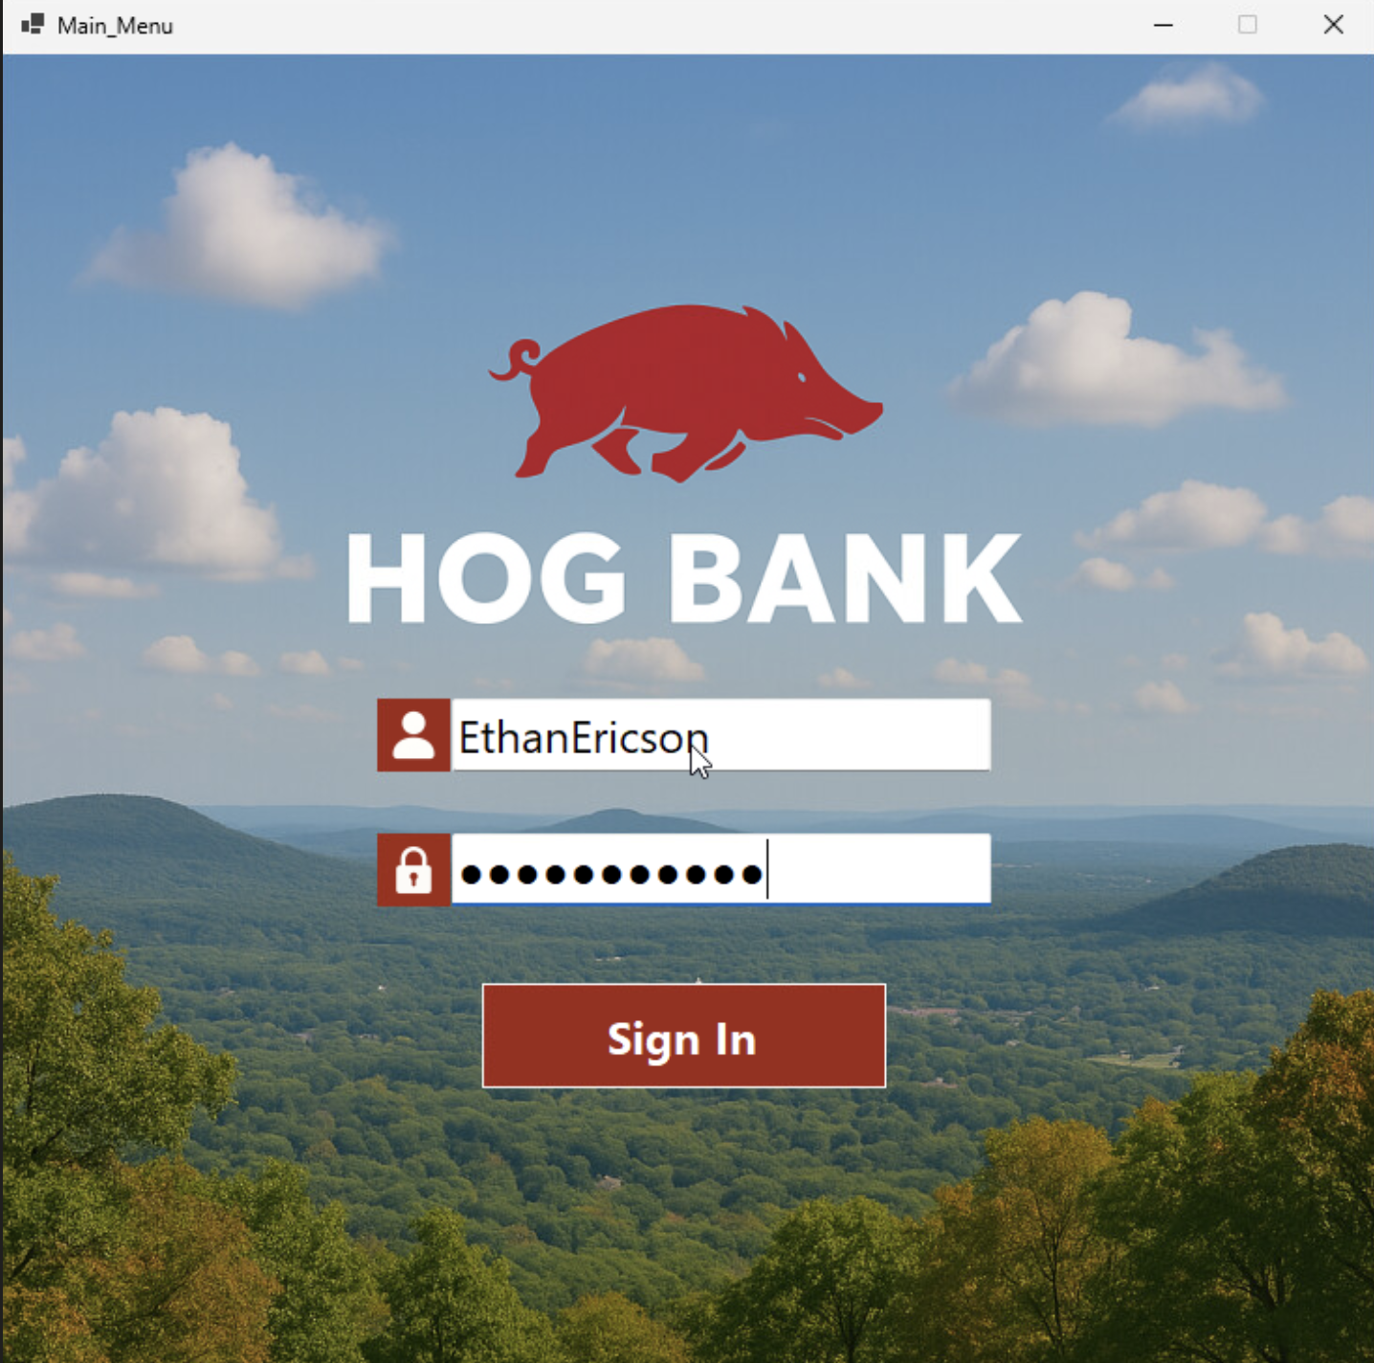
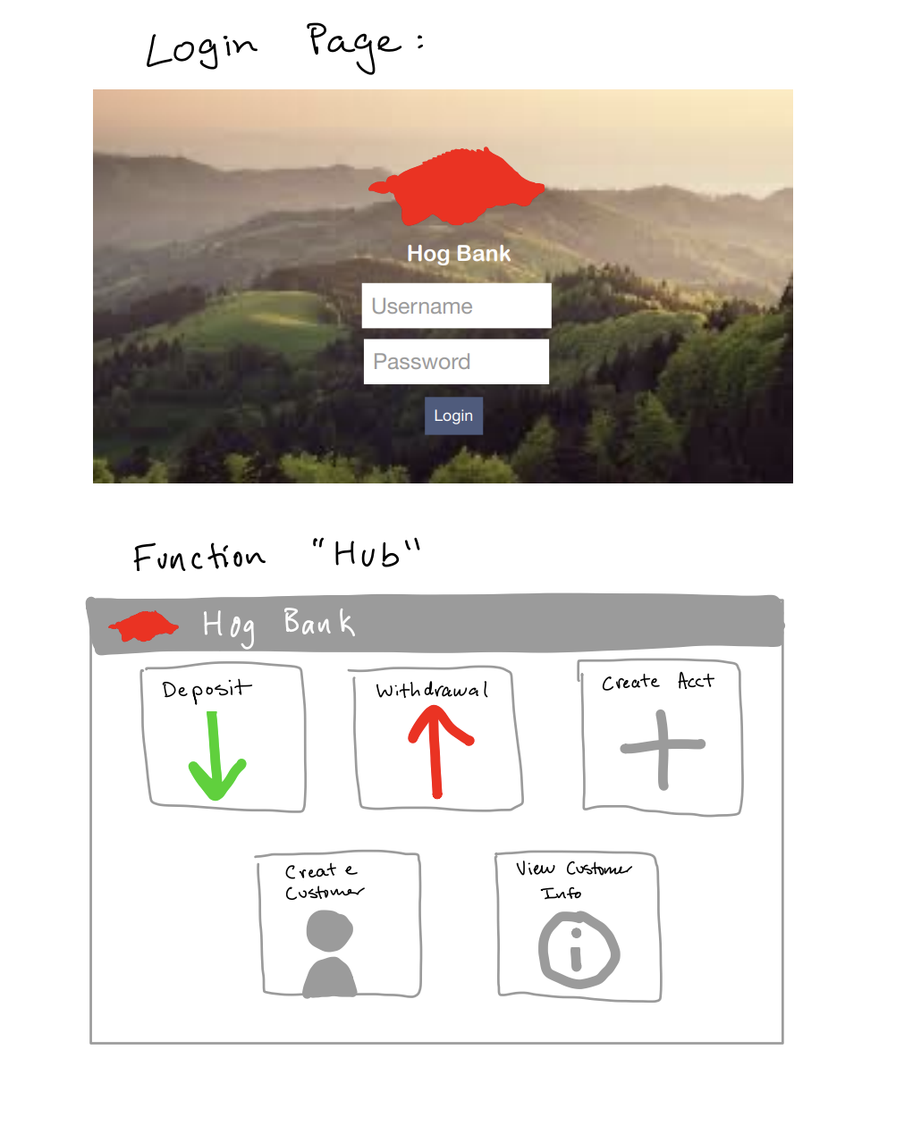
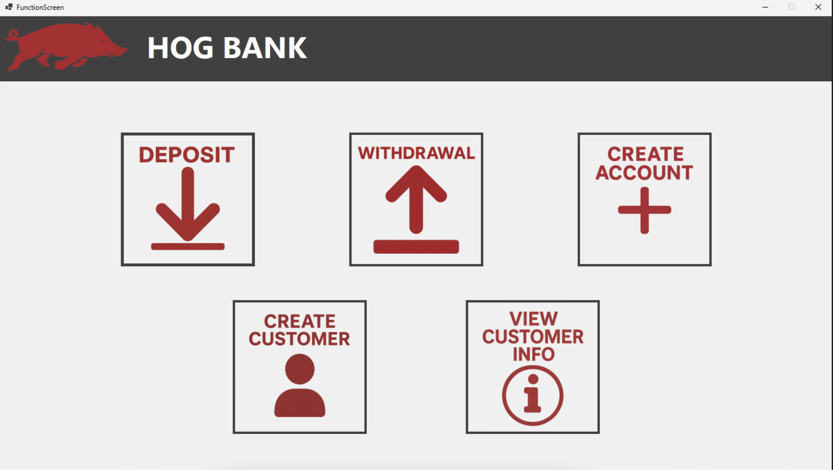
Non-Functional Prototype
Notes:
Andrew

Slide 12
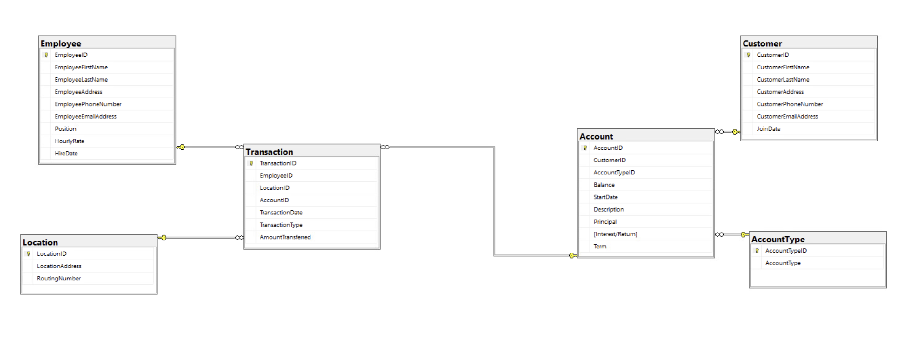
Physical Database Design
Notes:
Medhansh

Slide 13
Demonstration
Notes:
Ericson

Slide 14
Reflections
Create Account
Updating Transactions with New IDs
Employee Login
Creating public class with global access
Dynamic Process
Redesigning between phases
Notes:
Andrew
Medhansh
Ericson

Slide 15

Any Questions?

